Slide 1

NAD Manager – NAD Proxy Archtecture
17/10/2023
Software Engineering Team - LGEDV

Slide 2
Agenda
Project Overview
Architectural Drivers
Architectural Decision - Performance - Scalability - Extensibility - Availability
Verification
Architectural Representation - Static View - Dynamic View - Interface
Appendix.

Slide 3
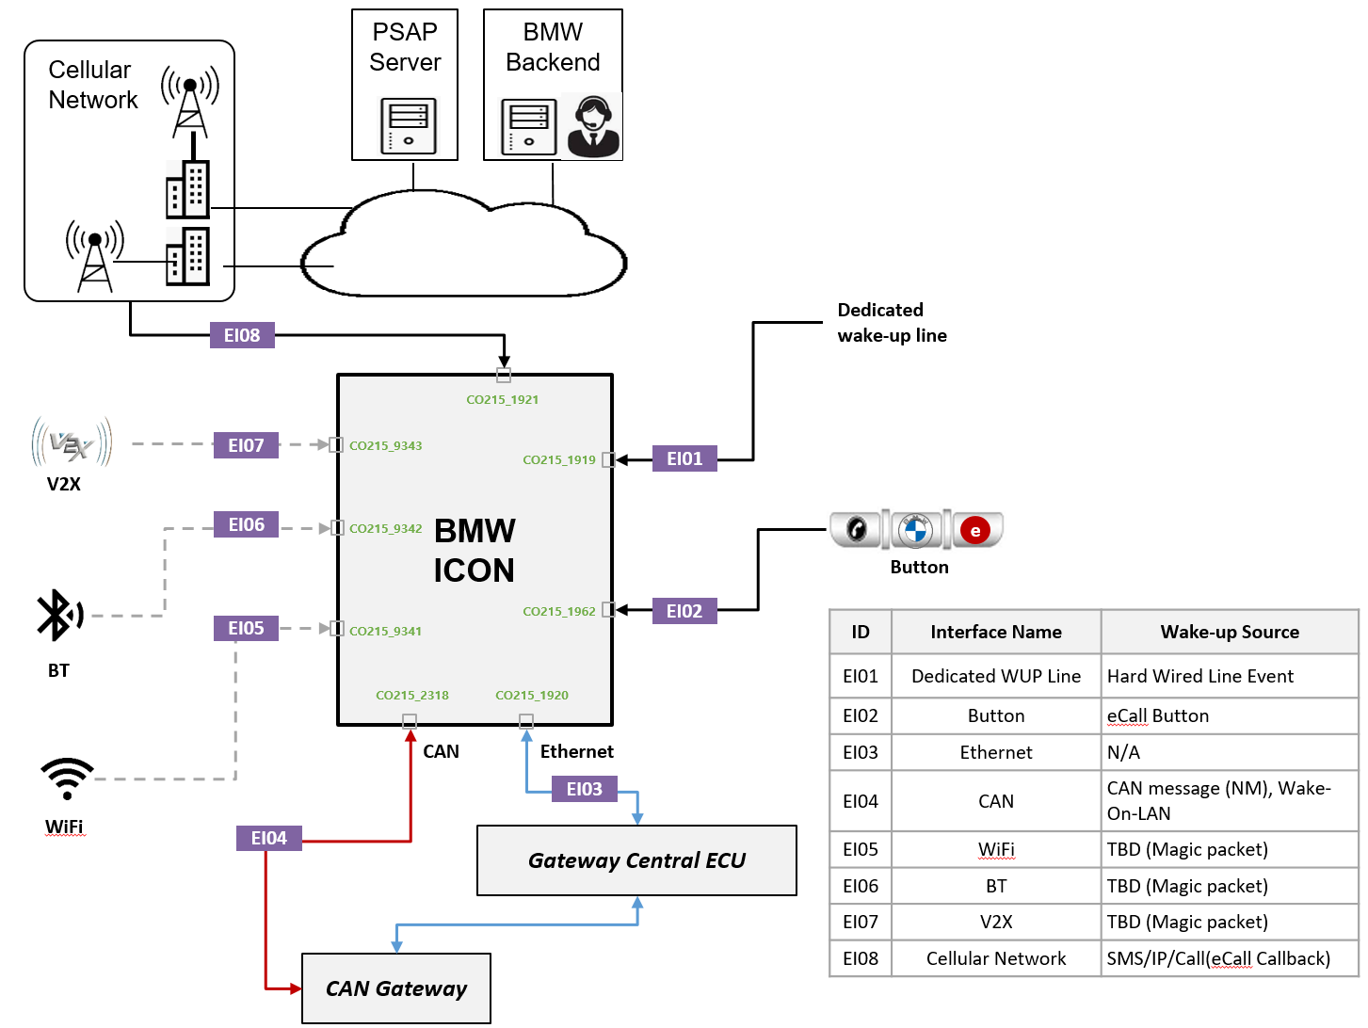
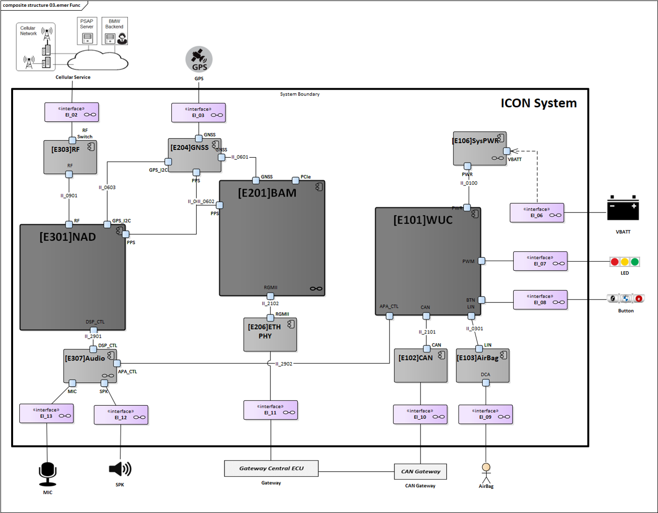
1. Project Overview

Slide 4
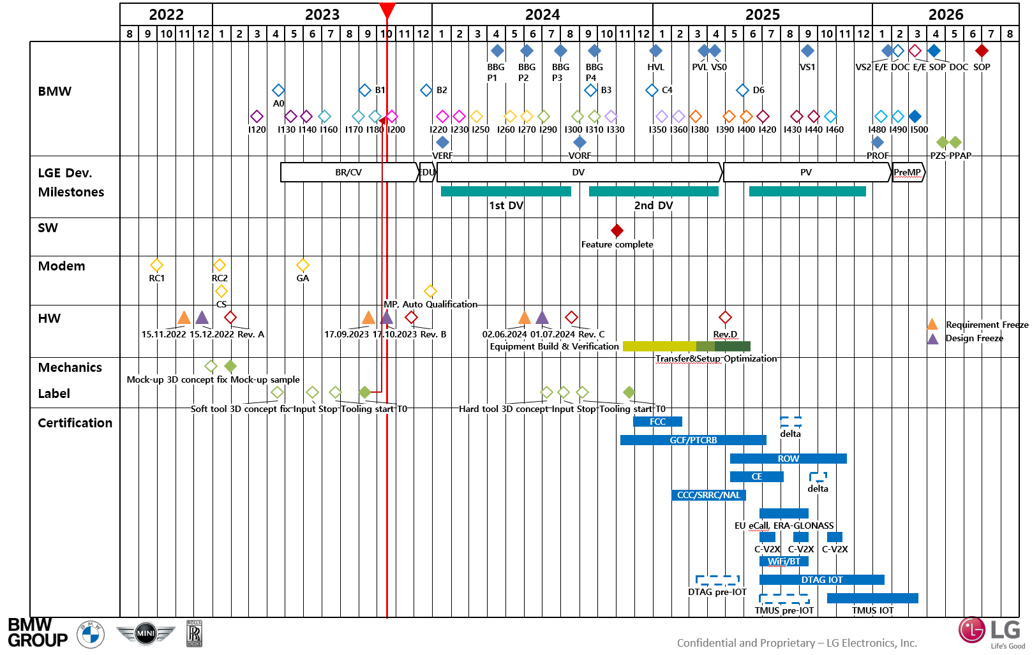
1. Project Overview

Slide 5
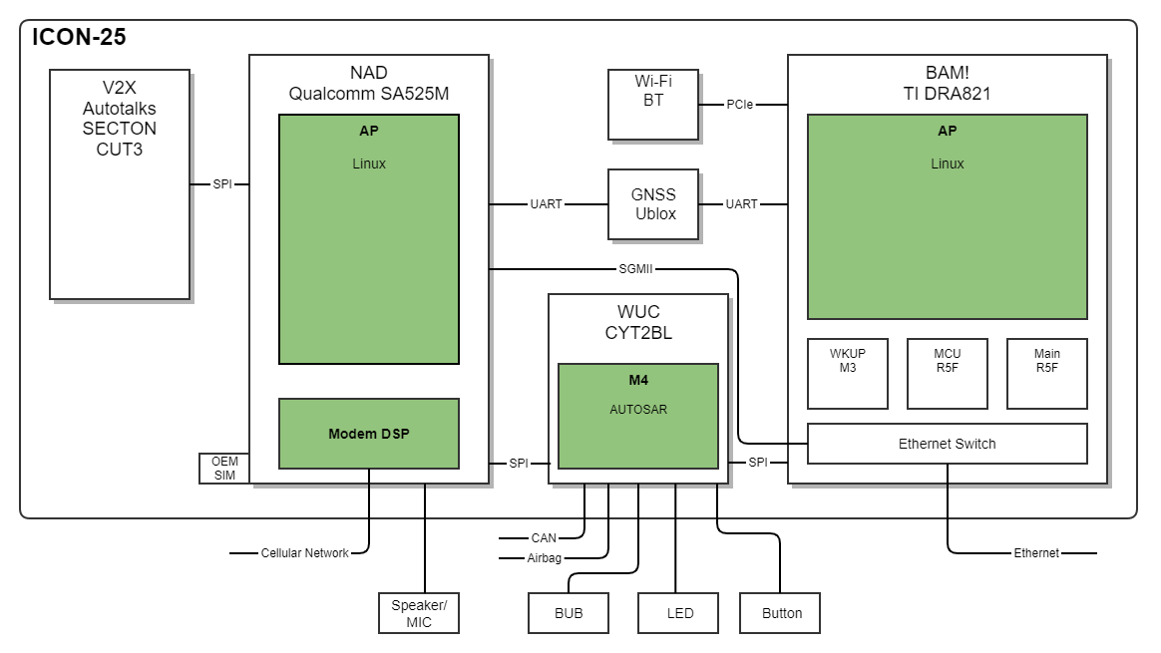
2. Project Context – System Context Diagram
System Context Diagram

Slide 6
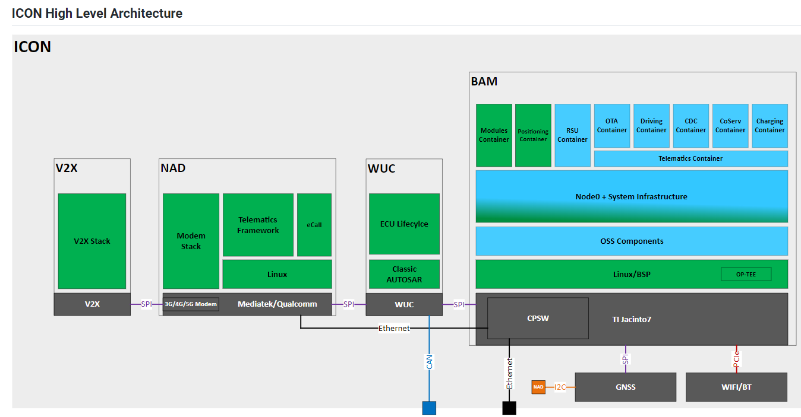
2. Project Context – Overall SW Context Diagram
Overall Context Diagram

Slide 7
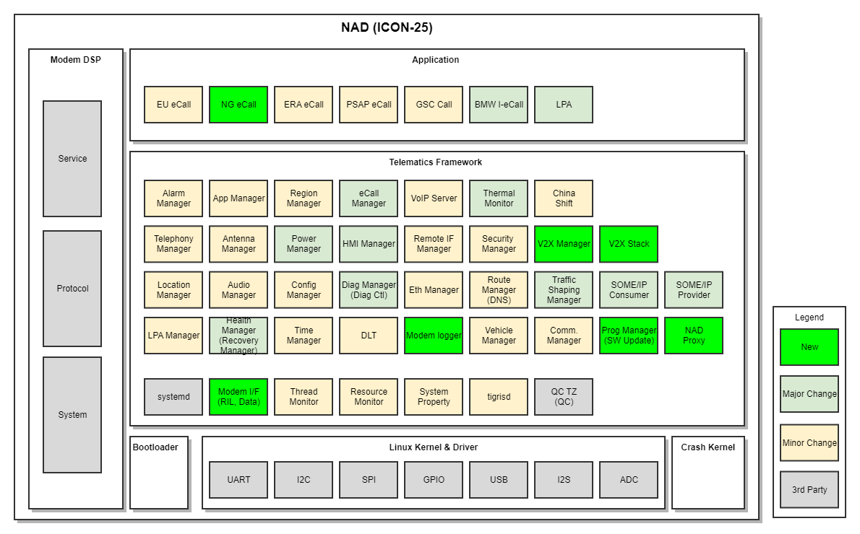
2. Project Context – NAD SW Components
NAD SW Components

Slide 8
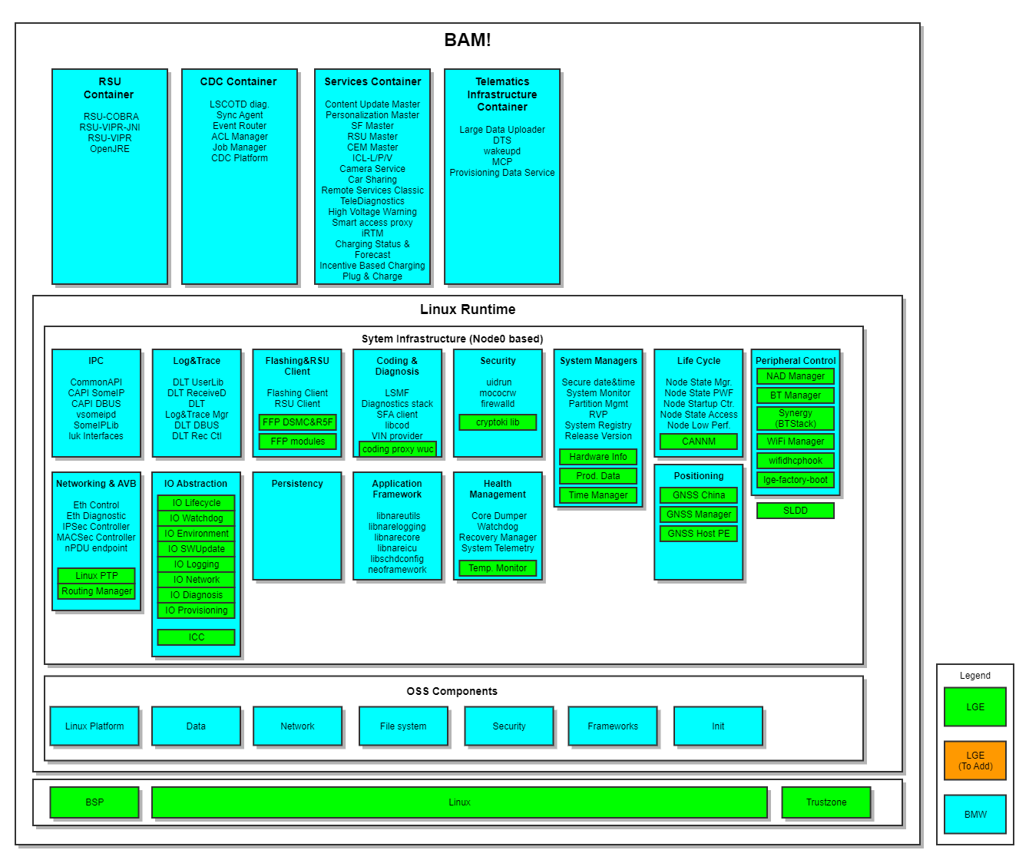
2. Project Context – BAM SW Components
BAM SW Components

Slide 9
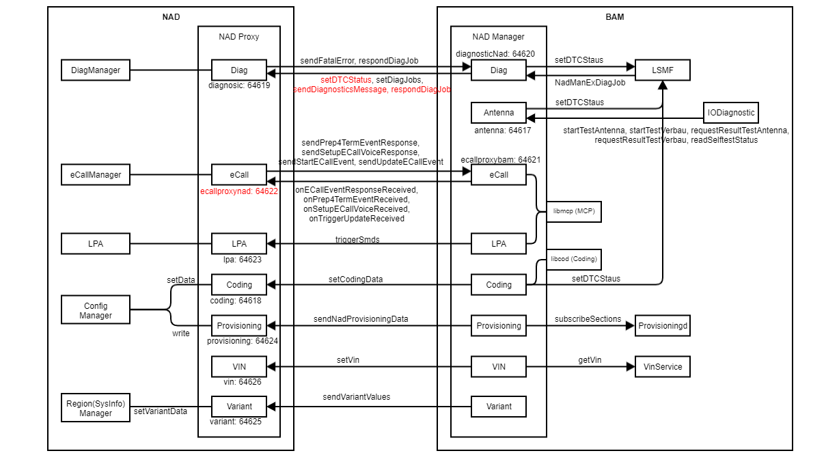
2. Project Context – NAD Manager vs NAD Proxy
NAD Manager and NAD Proxy communication

Slide 10
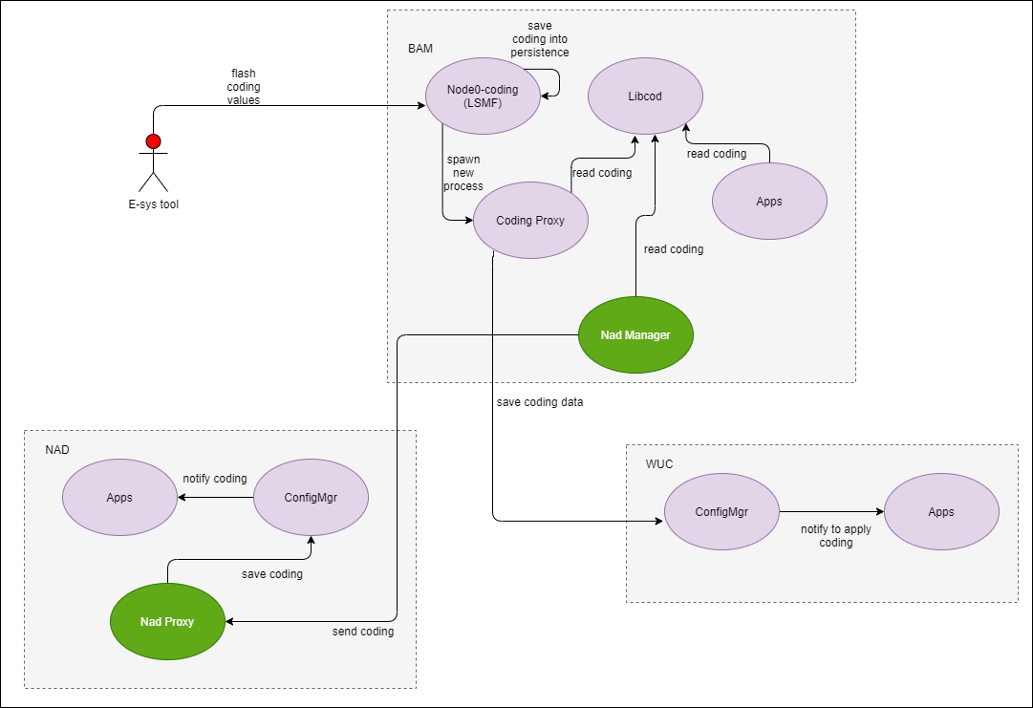
2. Use case
Send coding data

Slide 11
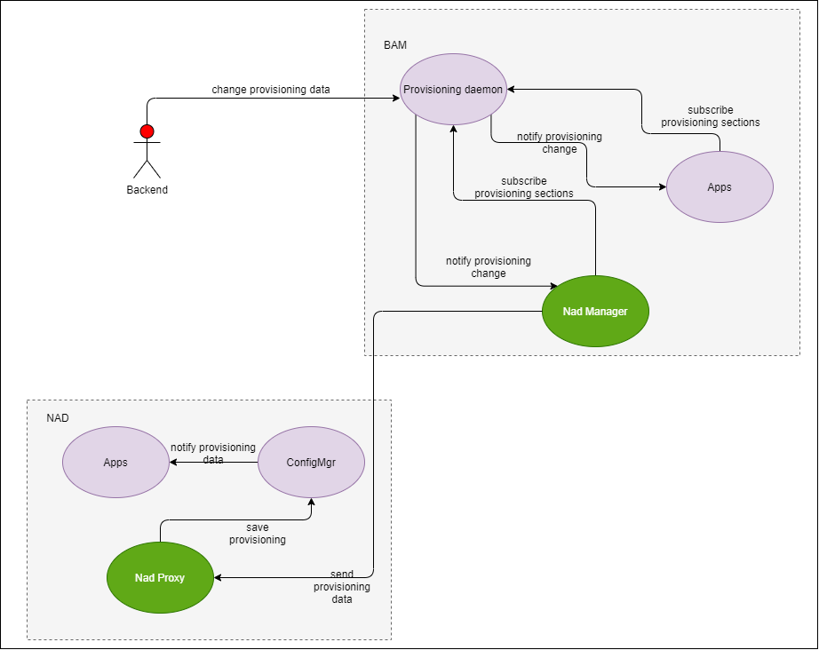
2. Use case
Send Provisioning data

Slide 12
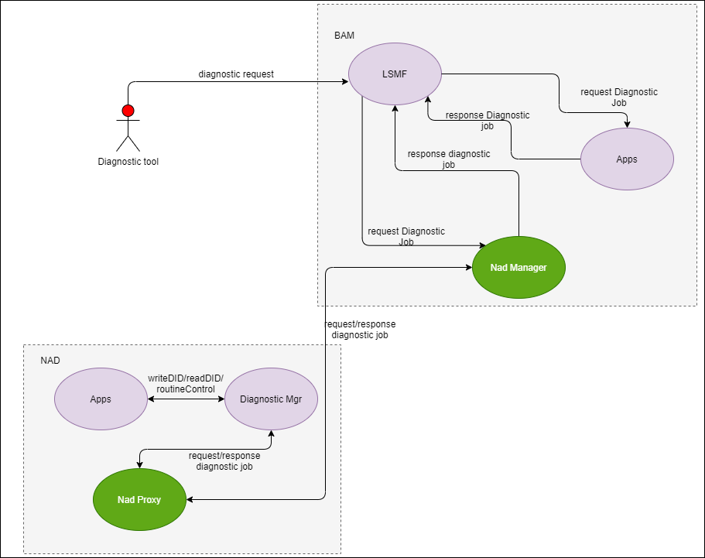
2. Use case
Send Diagnostic request

Slide 13
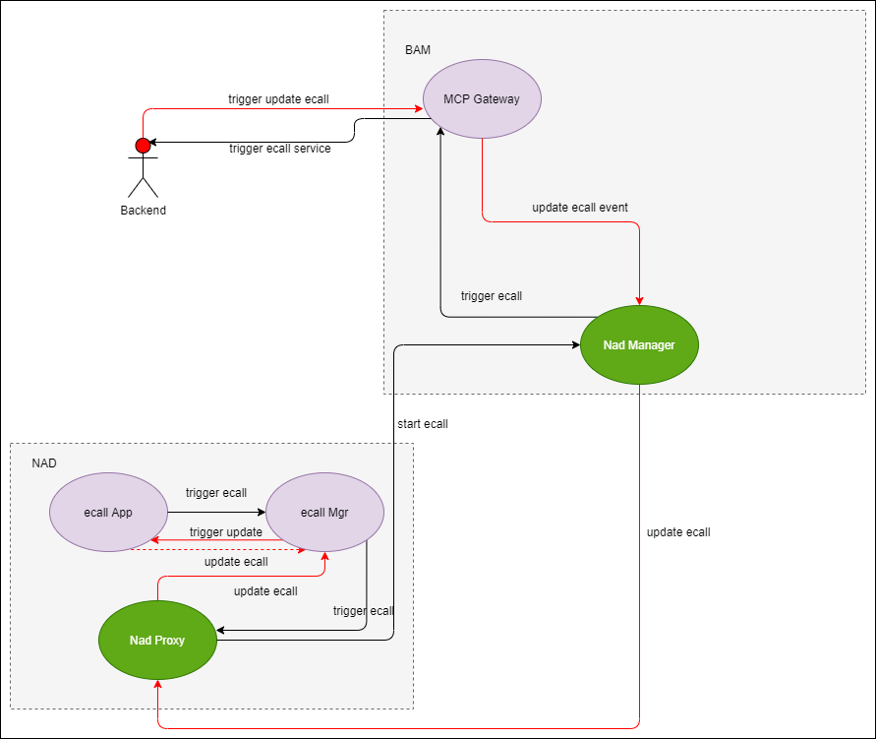
2. Use case
Send ECall request

Slide 14
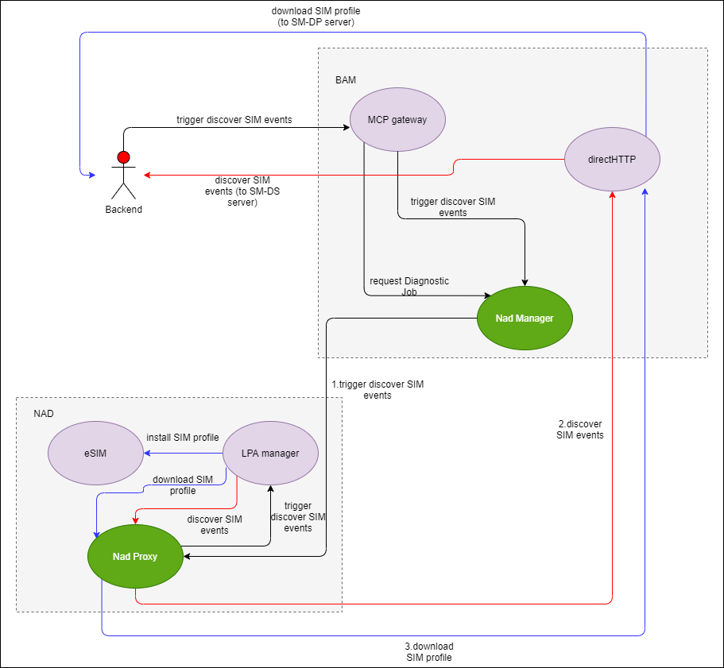
2. Use case
Send LPA request

Slide 15
3. Architectural Drivers
High-level Functional Requirement
Req. ID | Descriptions | Related Domain | Source
REQ-FR-NMP-01 | Coding parameters for non-BAM components such as WiFi, eCall, GNSS must be processed from BAM and forward to NAD. Coding parameters then be applied on relevant applications on NAD. | Coding | BMW requirement
REQ-FR-NMP-02 | System must support following diagnostic jobs: All BMW SIM communication and status checks (LPA functionality). GNSS diagnose job requests are processed and forwarded to GNSS chipset or positioning engines. All provisioning related Jobs in V2X. All E-Call related Jobs to check E-Call status. | Diagnostic, provisioning, E-call,V2X,GNSS, LPA. | BMW requirement
REQ-FR-NMP-03 | Be sure that provisioning sections are requested to BMW provisioningd to be included on the provisioning/DAS file. Provisioning non-BAM module is only responsible for forwarding the data from BAM provisioning. | Provisioning | BMW requirement
REQ-FR-NMP-04 | Covers the functionality of polling the SM-DS server in order to retrieve SIM Subscription Management events to be executed by the LPA | LPA | BMW requirement
REQ-FR-NMP-05 | Covers the functionality of downloading a SIM profile from a SM-DP+ according to BMW process specification | LPA | BMW requirement
REQ-FR-NMP-06 | Functional automatic and manual eCall trigger type of data transmission can be configured via provisioning value. Initial data is collected and sent out via MCP and SMS data update can be requested. | E-Call | BMW requirement
REQ-FR-NMP-07 | BMW ECall Receiving data from a BMW backend system. | E-Call | BMW requirement
REQ-FR-NMP-08 | BMW ECall Sending update data to a BMW backend system when CRQM timer expired. | E-Call | BMW requirement
REQ-FR-NMP-09 | BMW ECall Sending startEcall event data to a BMW backend system. | E-Call | BMW requirement
REQ-FR-NMP-10 | If backend sends trigger update request, eCall app will send update Event to backend. | E-Call | BMW requirement
REQ-FR-NMP-11 | BMW ECall Sending update data to a BMW backend system within CRQM Timer | E-Call | BMW requirement

Slide 16
Req. ID | Description | Domain | Source
REQ-FR-NMP-01 | Coding parameters for non-BAM components such as WiFi, eCall, GNSS must be processed from BAM and forward to NAD. Coding parameters then be applied on relevant applications on NAD. | Coding | BMW
REQ-FR-NMP-02 | System must support following diagnostic jobs: All BMW SIM communication and status checks (LPA functionality). GNSS diagnose job requests are processed and forwarded to GNSS chipset or positioning engines. All provisioning related Jobs in V2X. All E-Call related Jobs to check E-Call status | Diagnostic, provisioning, E-call,V2X,GNSS, LPA.
REQ-FR-NMP-03 | Be sure that provisioning sections are requested to BMW provisioningd to be included on the provisioning/DAS file. Provisioning non-BAM module is only responsible for forwarding the data from BAM provisioning. | Provisioning | BMW

Slide 17
3. Architectural Drivers
Quality Attribute
Quality Attribute Scenario Appendix part
Req. ID | Description | Attribute | Priority | Key QA

Slide 18
4.1 Architectural Decision - Performance
Related Quality Attribute
Usecae
REQ-QA-UCM-02

Slide 19
5. Verification

Slide 20
6.1 Architectural Representation - Static View
Static View

Slide 21
6.1 Architectural Representation - Static View (Decomposition)

Slide 22
6.2 Architectural Representation - Dynamic View
Usecase

